Slide 1


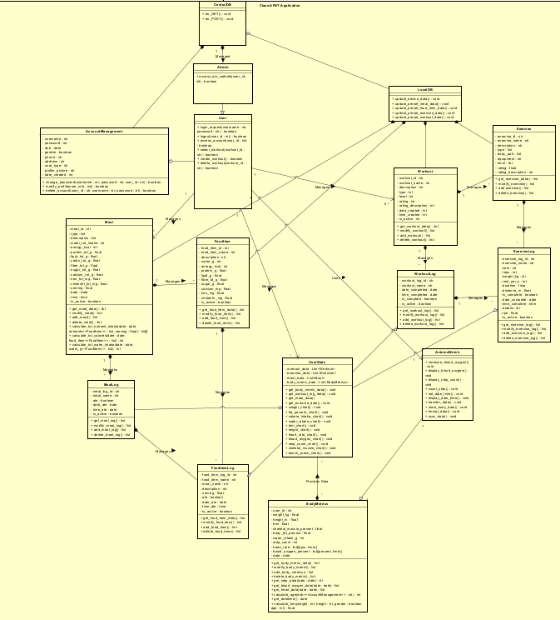
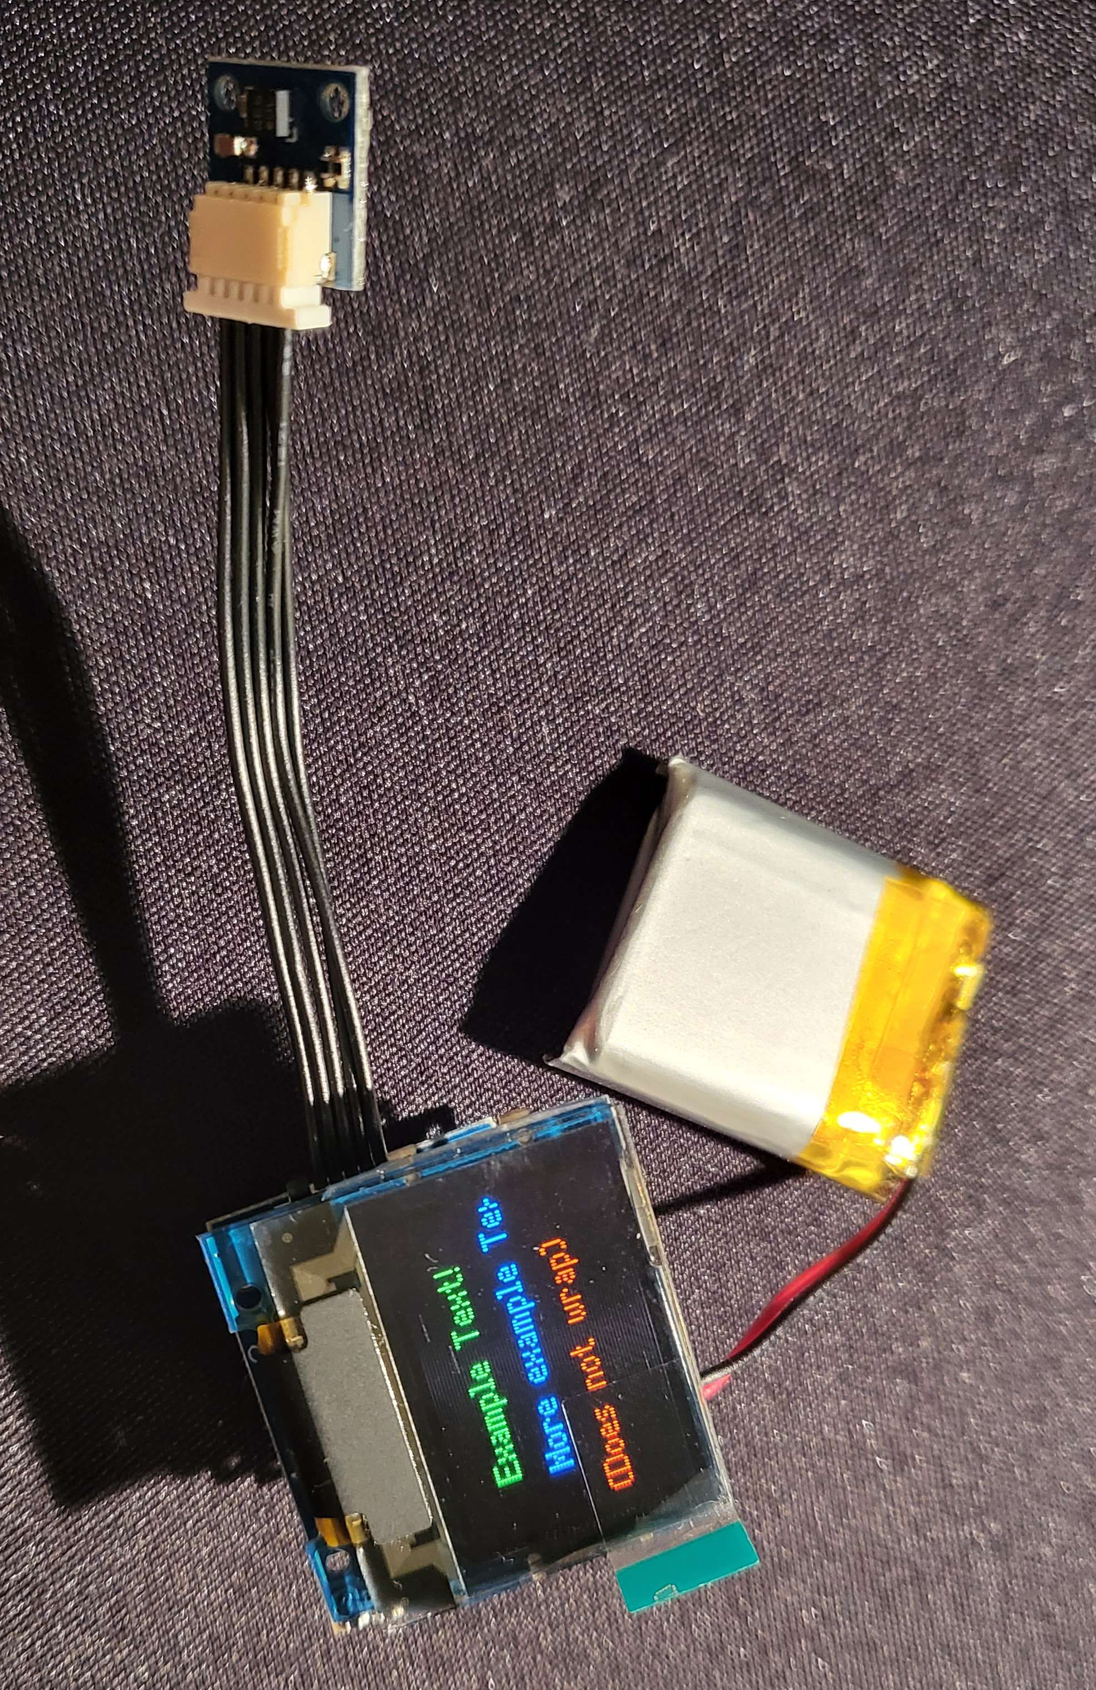
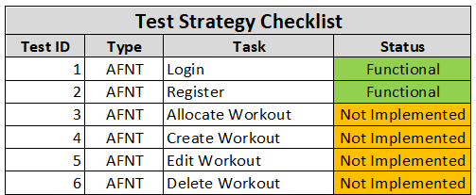
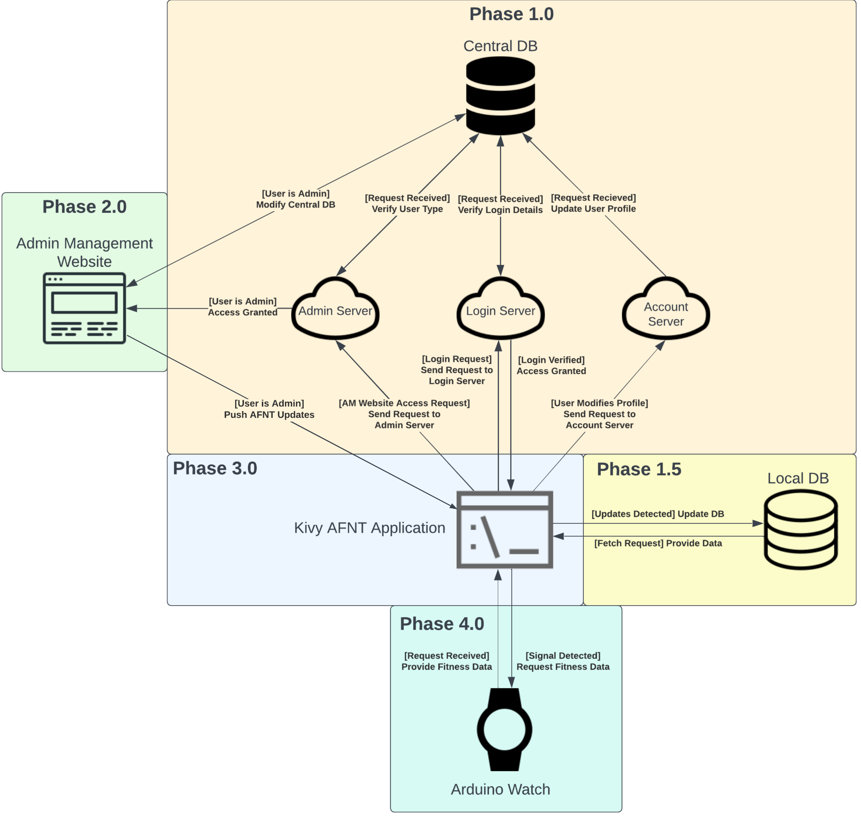
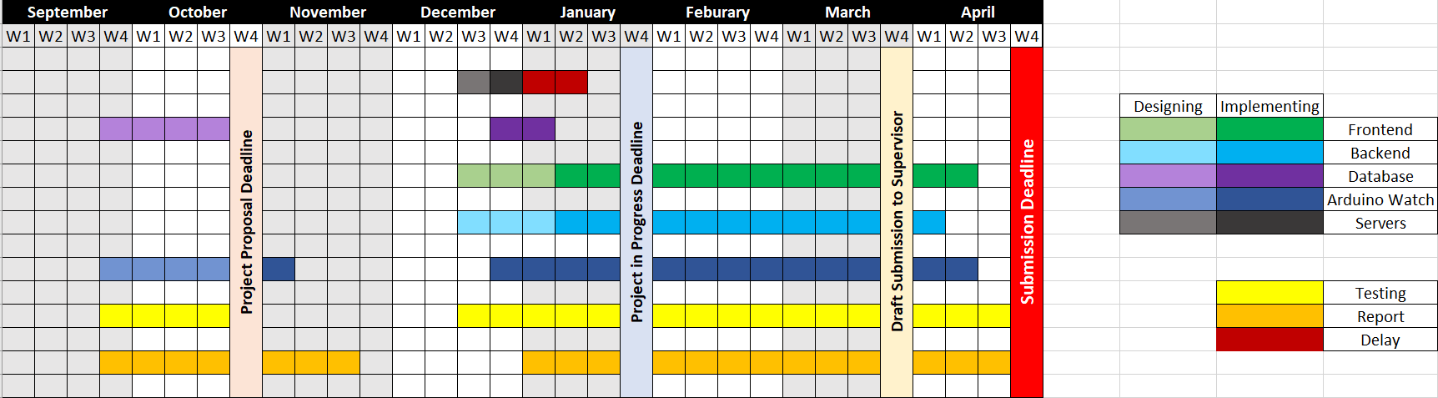
Research: Numerous studies have explored the impact of mobile apps, wearables, and connected devices on individuals' well-being. For instance, Smith et al. (2019) conducted a comprehensive review of health-related mobile applications, assessing their effectiveness in promoting physical activity and healthy lifestyles. The study critically analyzed the methodologies and outcomes of various apps, shedding light on their strengths and limitations. Another significant work in this domain is the research by Johnson and Brown (2020), who delved into the efficacy of smartwatches in monitoring and improving sleep patterns. Their critical examination of existing literature provided insights into the reliability and accuracy of sleep-tracking features, offering a nuanced perspective on the role of smartwatches in sleep management.
UFCFXK-30-3: Digital Systems Project
Student Name: Ali Suhail
Project Title: AFNT-Digital-Systems-Project
AFNT Project Demo Video
Abstract:
To design and implement a software solution focused on helping users achieve their fitness objectives. This involves developing a user-friendly platform for creating and customising workout routines, monitoring nutrition and workout progress, and offering health and fitness guidance. The main aim is to build an engaging and efficient fitness tool that encourages users to live healthier, more active lives.
Key requirements:
Functional
The AM website shall allow admins to modify the Central DB.
The AM website shall allow admins to push updates to the AFNT app.
The AFNT app shall allow users to add/modify/delete workouts.
The AFNT app shall allow users to add/modify/delete meals.
The AFNT app shall allow users to add/modify/delete body data.
The AFNT app shall allow users to generate progress reports.
The Arduino watch shall allow users to measure and store heart rate, blood oxygen and step count.
The Arduino watch shall allow users to transfer data to the AFNT app.
Non-functional
The AM website and AFNT shall support features to help users with disabilities.
The AM website and AFNT app should load under 2 seconds.
The AFNT app shall have a user-friendly interface with an SUS score of at least 70.
The watch should transfer data to AFNT with a latency of less than 200 milliseconds and a data transfer rate of at least 1 Mbps.
The Arduino watch shall display measure data in real time.
Implementation artefacts
Aims and objectives:
The project objectives are:
Develop a Scalable and Secure Database Management System (DBMS).
Build the Alistana Fitness & Nutrition Tracker (AFNT) Application for Desktop and Mobile which will be used for tracking workouts, meals and body progress.
Design an Admin Management Website (AM) to manage DBMS user accounts, preset workout and meal data, and push software updates to the AFNT Application.
Design and develop an Arduino Watch that tracks blood oxygen level, step count and exercise reps and sends data to the AFNT App.
Testing
Design, Implementation & Testing
AFNT Architecture
Planning and Management:
References:
Smith, A., Jones, B., & Johnson, C. (2019) Impact of Health-Related Mobile Applications on Physical Activity: A Comprehensive Review. Journal of Mobile Health, 7(2), pp. 45-62.
Johnson, R., & Brown, S. (2020) Efficacy of Smartwatches in Sleep Monitoring and Improvement: A Critical Review*. Sleep Research Journal, 15(3), pp. 112-129.

